Slide 1
Replication Crises and Hidden Controversies in Phil Stat
OVERVIEW
APRIL 3, 2019 6334/6614

Slide 2
High-profile failures of replication have brought forth reams of reforms
How should the integrity of science be restored?
Experts do not agree.
We need to pull back the curtain on why.

Slide 3
Hidden Controversies
The Statistics Wars: Age-old abuses, fallacies of statistics (Bayesian-frequentist, Fisher-N-P debates) simmer below todays debates; reformulations of frequentist methods are ignored
Replication Paradoxes: While a major source of handwringing stem from biasing selection effects—cherry picking, data dredging, trying and trying again, some reforms and preferred alternatives conflict with the needed error control.
3. Underlying assumptions and their violations
A) statistical model assumptions
B) links from experiments, measurements & statistical inferences to substantive questions

Slide 4
Significance Tests
The most used methods are most criticized
Statistical significance tests are a small part of a rich set of:
    “techniques for systematically appraising and bounding the probabilities … of seriously misleading interpretations of data” (Birnbaum 1970, 1033)
These I call error statistical methods (or sampling theory).

Slide 5
“p-value. …to test the conformity of the particular data under analysis with H₀ in some respect:
…we find a function T = t(y) of the data, to be called the test statistic, such that
the larger the value of T the more inconsistent are the data with H₀;
The random variable T = t(Y) has a (numerically) known probability distribution when H₀ is true.
…the p-value corresponding to any t_{0bs} as
p = p(t) = Pr(T ≥ t_{0bs}; H₀)”
(Mayo and Cox 2006, 81)

Slide 6
Testing Reasoning
If even larger differences than t_{0bs} occur fairly frequently under H₀ (i.e., P-value is not small), there’s scarcely evidence of incompatibility with H₀
Small P-value indicates some underlying discrepancy from H₀ because very probably you would have seen a less impressive difference than t_{0bs} were H₀ true.
This still isn’t evidence of a genuine statistical effect H₁, let alone a scientific conclusion H*
Stat-Sub fallacy H => H*

Slide 7

Neyman-Pearson (N-P) tests:
        A null and alternative hypotheses H₀, H₁ that are exhaustive
        H₀: μ ≤ 0 vs. H₁: μ > 0
So this fallacy of rejection H₁➔H* is impossible
Rejecting the null only indicates statistical alternatives (how discrepant from null)
As opposed to NHST

Slide 8
Get beyond N-P/ Fisher incompatibilist caricature
Beyond “inconsistent hybrid” (Gigerenzer 2004, 590): Fisher–inferential; N-P–long run performance
They both use a method’s sampling distribution to assess and control error probabilities
Results in P-value users robbed of features from N-P tests they need (power)
Wrongly supposes N-P testers have fixed error probabilities (no balance), & don’t report P-value

Slide 9
Replication Paradox
(for Significance Test Critics)
Critic: It’s much too easy to get a small P-value
You: Why do they find it so difficult to replicate the small P-values others found?
Is it easy or is it hard?

Slide 10
Both Fisher and N-P: it’s easy to lie with statistics by selective reporting
Sufficient finagling—cherry-picking, P-hacking, significance seeking, multiple testing, look elsewhere—may practically guarantee a preferred claim H gets support, even if it’s unwarranted by evidence

Slide 11
Severity Requirement:
Everyone agrees: If the test had little or no capability of finding flaws with H (even if H is incorrect), then agreement between data x₀ and H provides poor (or no) evidence for H
(“too cheap to be worth having” Popper 1983, 30)
  Such a test fails a minimal requirement for a stringent or severe test
  My account: severe testing based on error statistics (requires reinterpreting tests)

Slide 12
This alters the role of probability: typically just 2
Probabilism. To assign a degree of probability, confirmation, support or belief in a hypothesis, given data x₀
(e.g., Bayesian, likelihoodist)—with regard for inner coherency
Performance. Ensure long-run reliability of methods, coverage probabilities (frequentist, behavioristic Neyman-Pearson)

Slide 13
Problems with selective reporting, cherry picking, stopping when the data look good, P-hacking, are not problems about long-runs—
It’s that we cannot say the case at hand has done a good job of avoiding the sources of misinterpreting data
Key to revising the role of error probabilities

Slide 14
A claim C is not warranted _______
Probabilism: unless C is true or probable (gets a probability boost, is made comparatively firmer)
Performance: unless it stems from a method with low long-run error
Probativism (severe testing) unless something (a fair amount) has been done to probe ways we can be wrong about C

Slide 15
Biasing selection effects:
One function of severity is to identify problematic selection effects (not all are)
Biasing selection effects: when data or hypotheses are selected or generated (or a test criterion is specified), in such a way that the minimal severity requirement is violated, seriously altered or incapable of being assessed
Compare to explaining a known effect (SIST p. 281), as in DNA matching

Slide 16
Nominal vs. actual Significance levels
  SIST p. 275
  Suppose that twenty sets of differences have been examined, that one difference seems large enough to test and that this difference turns out to be ‘significant at the 5 percent level.’ ….The actual level of significance is not 5 percent, but 64 percent! (Selvin 1970, 104)
From (Morrison & Henkel’s Significance Test controversy 1970!)

Slide 17
Spurious P-Value
You report: Such results would be difficult to achieve under the assumption of H₀
When in fact such results are common under the assumption of H₀
There are many more ways you can be wrong with hunting (different sample space)
(Formally):
You say Pr(P-value ≤ P_{obs}; H₀) ~ P_{obs} = small
But in fact Pr(P-value ≤ P_{obs}; H₀) = high

Slide 18
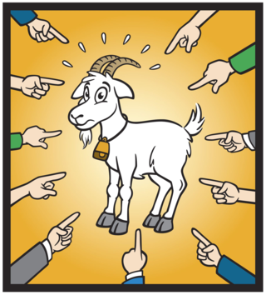
Scapegoating
Nowadays, we’re likely to see the tests blamed
My view: Tests don’t kill inferences, people do
Even worse are those statistical accounts where the abuse vanishes!

Slide 19
Some say taking account of biasing selection effects “defies scientific sense” SIST P. 269
  Two problems that plague frequentist inference: multiple comparisons and multiple looks, or, as they are more commonly called, data dredging and peeking at the data. The frequentist solution to both problems involves adjusting the P-value…
  But adjusting the measure of evidence because of considerations that have nothing to do with the data defies scientific sense” (Goodman 1999, 1010)
  (To his credit, he’s open about this; heads the Meta-Research Innovation Center at Stanford)

Slide 20
Likelihood Principle (LP)
The vanishing act links to a pivotal disagreement in the philosophy of statistics battles
In probabilisms, the import of the data is via the ratios of likelihoods of hypotheses
Pr(x₀;H₀)/Pr(x₀;H₁)
The data x₀ are fixed, while the hypotheses vary

Slide 21
Jimmy Savage on the LP:
“According to Bayes' theorem,…. if y is the datum of some other experiment, and if it happens that P(x|µ) and P(y|µ) are proportional functions of µ (that is, constant multiples of each other), then each of the two data x and y have exactly the same thing to say about the values of µ…” (Savage 1962, p. 17)

Slide 22
All error probabilities violate the LP
(even without selection effects):
Sampling distributions, significance levels, power, all depend on something more [than the likelihood function]–something that is irrelevant in Bayesian inference–namely the sample space
(Lindley 1971, 436)
The LP implies…the irrelevance of predesignation, of whether a hypothesis was thought of before hand or was introduced to explain known effects (Rosenkrantz 1977, 122) SIST P. 269

Slide 23
Optional Stopping:
Error probing capacities are altered not just by cherry picking and data dredging, but also via data dependent stopping rules:
X_{i} ~ N(μ, σ²), 2-sided H₀: μ = 0 vs. H₁: μ ≠ 0.
Instead of fixing the sample size n in advance, in some tests, n is determined by a stopping rule:

Slide 24
Keep sampling until H₀ is rejected at 0.05 level
i.e., keep sampling until M > 1.96 σ/√n
Trying and trying again: Having failed to rack up a 1.96 σ/√n difference after 10 trials, go to 20, 30 and so on until obtaining a 1.96 σ difference

Slide 25
Nominal vs. Actual significance levels again:
With n fixed the Type 1 error probability is 0.05
With this stopping rule the actual significance level differs from, and will be greater than 0.05
(proper stopping rule)

Slide 26
Probabilist side:
Jmmie Savage (1961, 583) declared:
“optional stopping is no sin”
so the problem must be with significance levels (because they pick up on it).
Performance (and probative testing) side:
Peter Armitage:
“thou shalt be misled”
if thou dost not know the person tried and tried again. (1962, 72)

Slide 27
Equivalently, you can ensure that 0 is excluded from a confidence interval (or credibility interval) even if true (Berger and Wolpert 1988)
Likewise the same p-hacked hypothesis can occur in Bayes factors, credibility intervals, likelihood ratios

Slide 28
With One Big Difference:
The direct grounds to criticize inferences as flouting error statistical control is lost
They condition on the actual data,
Error probabilities take into account other outcomes that could have occurred but did not (sampling distribution)

Slide 29
What Counts as Cheating? SIST P. 270
“[I]f the sampling plan is ignored, the researcher is able to always reject the null hypothesis, even if it is true. This example is sometimes used to argue that any statistical framework should somehow take the sampling plan into account. Some people feel that ‘optional stopping’ amounts to cheating…. This feeling is, however, contradicted by a mathematical analysis. (Eric-Jan Wagenmakers, 2007, 785)
But the “proof” assumes the likelihood principle (LP) by which error probabilities drop out. (Edwards, Lindman, and Savage 1963)

Slide 30
Replication researchers (re)discovered that data-dependent hypotheses and stopping are a major source of spurious significance levels.
“Authors must decide the rule for terminating data collection before data collection begins and report this rule in the articles” (Simmons, Nelson, and Simonsohn 2011, 1362).
Or report how their stopping plan alters relevant error probabilities.

Slide 31
Critic: It’s too easy to satisfy standard significance thresholds
You: Why do replicationists find it so hard to achieve significance thresholds (with preregistration)?
Critic: Obviously the initial studies were guilty of P-hacking, cherry-picking, data-dredging (QRPs)
You: So, the replication researchers want methods that pick up on, adjust, and block these biasing selection effects.
Critic: Actually “reforms” recommend methods where the need to alter P-values due to data dredging vanishes

Slide 32
SIST p.49

Slide 33
Default Bayesian Reforms are touted as free of selection effects
“…Bayes factors can be used in the complete absence of a sampling plan…”
(Bayarri, Benjamin, Berger, Sellke 2016, 100)

Slide 34
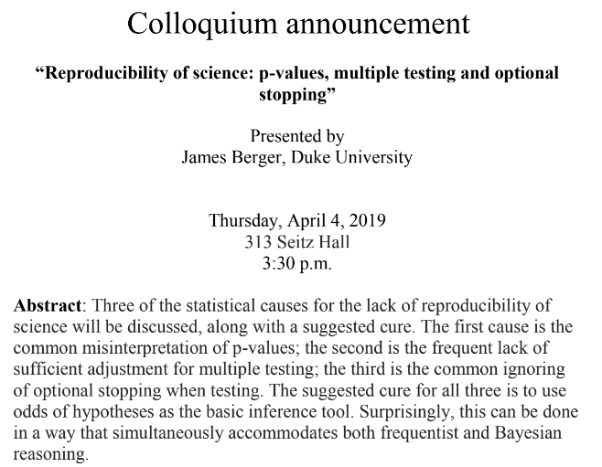

Slide 35

Recent push to “redefine statistical significance” is based on the odds ratios/ Bayes Factors (BF)
(Benjamin et al 2017)

Slide 36
Old & new debates: P-values exaggerate based on Bayes Factors or Likelihood Ratios
Testing of a point null hypothesis, a lump of prior probability given to H₀
X_{i} ~ N(μ, σ²), 2-sided H₀: μ = 0 vs. H₁: μ ≠ 0.
The criticism is the posterior probability on H₀ can be larger than the P-value.
So if you interpret a P-value as a posterior on H₀ (a fallacy), you’d be saying the Pr(H₀|x) is low

Slide 37
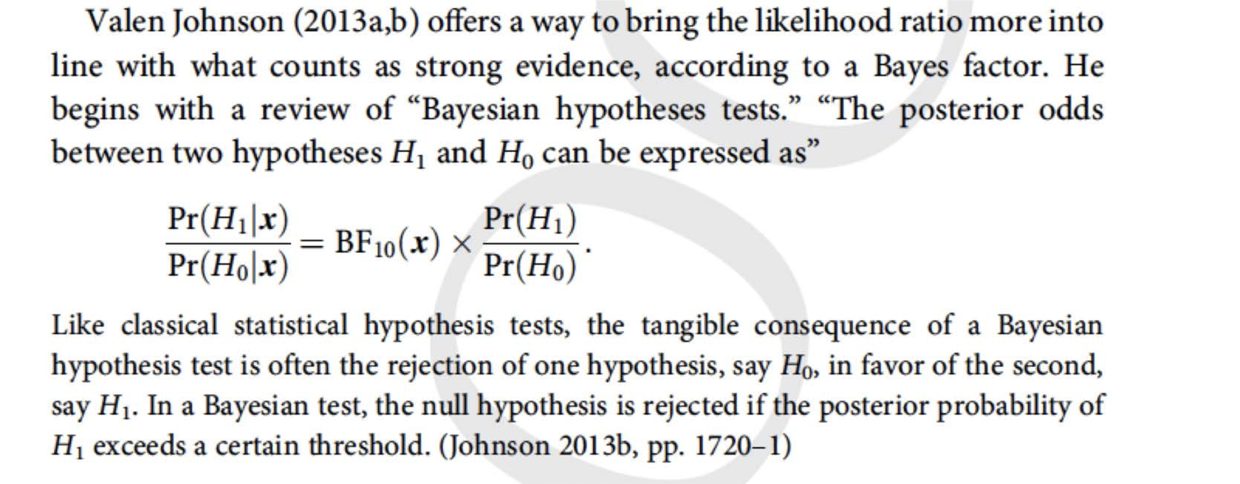
SIST p. 261

Slide 38
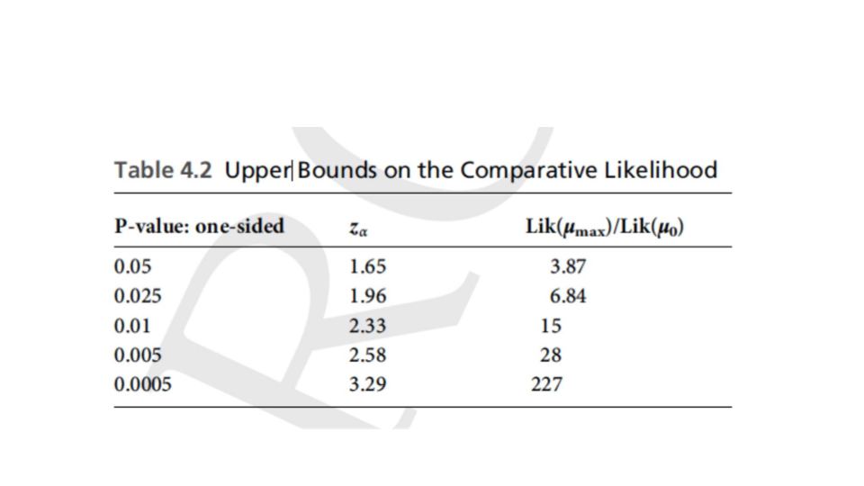
SIST p. 260: Table 4.2

Slide 39
Do P-values Exaggerate Evidence?
Don’t reject the null until the BF is 20 or 28
Significance testers balk at allowing highly significant results to be interpreted as no evidence against the null–or even evidence for it!
Bad Type II error
Lump of prior on the null conflicts with the idea that all nil nulls are false)
P-values can also equal the posterior! (without the spiked prior)–even though they measure very different things.

Slide 40
When you reject with p = 0.005, you can assign a posterior of .97 to μ ≥ observed sample mean
(the max likely value), but there’s terrible evidence for this!!!
This is like using a confidence level of .5
The severity is .5
To base the argument on lowering P-values on BFs –if you don’t do inference by means of BFs– is not innocuous
SIST p. 266 Accepting the LP, Johnson’s convinced the problem is merely using p-vaues not low enough

Slide 41
BF Advocates Forfeit Their Strongest Criticisms
Daryl Bem (2011): subjects did better than chance at predicting the picture to be shown in the future, credit to ESP (SIST P. 283)
Admits data dredging
Keen to show we should trade significance tests for BFs, critics relinquish their strongest criticism
Resort to a default Bayesian prior to make the null hypothesis comparatively more probable than a chosen alternative

Slide 42
Bem’s Response
Whenever the null hypothesis is sharply defined but the prior distribution on the alternative hypothesis is diffused over a wide range of values, as it is [here] it boosts the probability that any observed data will be higher under the null hypothesis than under the alternative. This is known as the Lindley-Jeffreys paradox: A frequentist analysis that yields strong evidence in support of the experimental hypothesis can be contradicted by a misguided Bayesian analysis that concludes that the same data are more likely under the null. (Bem et al., 717)

Slide 43
Bayes-Fisher Disagreement or Jeffreys-Lindley “Paradox”
With-a lump of prior given to the point null, and the rest appropriately spread over the alternative, an α significant result can correspond to
Pr(H₀ |x) = (1 - α)! (e.g., 0.95)
“spike and smear”
To a Bayesian this shows P-values exaggerate evidence against

Slide 44
Admittedly, significance tests require supplements to avoid overestimating (or underestimating) effect sizes
That’s what severity does

Slide 45
Severity for Test T+:
SEV(T+, d(x₀), claim C)
Normal testing: H₀: μ ≤ μ₀ vs. H₁: μ > μ₀ known σ; discrepancy parameter γ; μ₁ = μ₀ +γ; d₀ = d(x₀) (observed value of test statistic) √n(M - μ₀)/σ
SIR: (Severity Interpretation with low P-values)
(a): (high): If there’s a very low probability that so large a d₀ would have resulted, if μ were no greater than μ₁, then d₀ it indicates μ > μ₁: SEV(μ > μ₁) is high.
(b): (low) If there is a fairly high probability that d₀ would have been larger than it is, even if μ = μ₁, then d₀ is not a good indication μ > μ₁: SEV(μ > μ₁) is low.

Slide 46
SIN: (Severity Interpretation for Negative results)
(a): (high) If there is a very high probability that d₀ would have been larger than it is, were μ > μ₁, then μ ≤ μ₁ passes the test with high severity: SEV(μ ≤ μ₁) is high.
(b): (low) If there is a low probability that d₀ would have been larger than it is, even if μ > μ₁, then μ ≤ μ₁ passes with low severity: SEV(μ ≤ μ₁) is low.

Slide 47
Hidden Controversies
The Statistics Wars: Age-old abuses, fallacies of statistics (Bayesian-frequentist, Fisher-N-P debates) simmer below todays debates; reformulations of frequentist methods are ignored
Replication Paradoxes: While a major source of handwringing stem from biasing selection effects—cherry picking, data dredging, trying and trying again, some reforms and preferred alternatives conflict with the needed error control.
3. Underlying assumptions and their violations
A) statistical model assumptions
B) links from experiments, measurements & statistical inferences to substantive questions

Slide 48
Recognize different roles of probability: probabilism, long run performance, probativism (severe testing)
Move away from cookbook stat–long deplored–but don’t expect agreement on numbers from evaluations of different things (P-values, posteriors)
Recognize criticisms & reforms are often based on rival underlying philosophies of evidence
The danger is that some reforms may enable rather than directly reveal illicit inferences due to biasing selection effects
Worry more about model assumptions, and whether our experiments are teaching us about the phenomenon of interest

